Slide 1
Faster Sample-based Motion Planning using Instance-based Learning
Jia Pan, Sachin Chitta*, Dinesh Manocha
UNC Chapel Hill, *Willow Garage
http://gamma.cs.unc.edu/IBL

Slide 2
Main Contributions
Keep a database of the outcome of all collision queries generated during sample-based planning
Store collision-free and in-collision queries
Perform efficient update and query
Efficient k-NN based reasoning on the database to perform probabilistic collision queries
Use probabilistic collision queries to improve the performance of all sample-based planners
Guarantees on probabilistic completeness

Slide 3
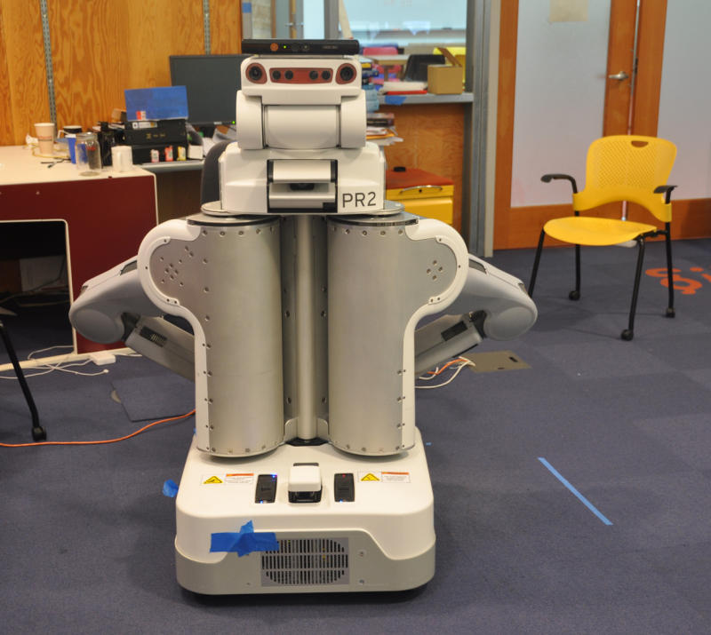
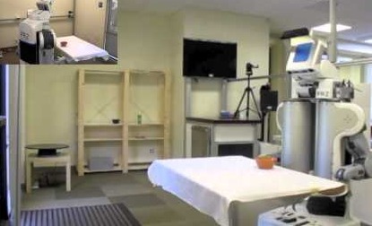
Motivation
Most robots work in environments which don’t change too much
Improve planner’s performance by exploiting the knowledge learned from prior C-space probes
Notes:
For example, in domestic environment, wall and shelves are fixed. Large objects like furniture and kitchen tools are places in a limited number of places.

Slide 4
Learning from Experience: Three Levels
Low level
High level
need pre/post-processing
need repair/adjustment
low-level data
collision queries
high-level planning
store, update and learn from raw sensor data
learn an approximate description of C-obstacles and C-free
store and reuse trajectories from prior results
Wurm, Hornung, Bennewitz, Stachniss & Burgard, 2010
PCL [Rusu et al.]
Our Work
Branicky, Knepper & Kuffner, 2008
Zucker, Kuffner & Bagnell, 2008
Jetchev and Toussaint, 2008
Erickson & Lavalle, 2009
Berenson, Abbeel & Goldberg, 2012
Phillips, Cohen, Chitta, Likhachev, 2012
compact encoding of the environment which can be used by any planners

Slide 5
Proximity Queries: Cost
How to reduce the cost of collision tests?
Less expensive
Exact Distance computation
Exact Collision computation
Probabilistic Collision Computation
Probabilistic collision queries
About an order of magnitude faster than exact query
Probability of wrong answer is small and bounded
Doesn’t affect the completeness or optimality of the planner

Slide 6
Overall Pipeline
conservative?
Exact Collision Module
exact collision
YES
NO
update database
update database
collision-free
YES
configuration
collision?
q₀
Y
q_{new}
q₁
N
…
prob. small?
q_{n}
Y
collision prob.
q_{new}
N
NO
Y
Database of C-space probes
update database
We prove that the replacement of exact collision query by probabilistic collision query will NOT change the completeness or optimality of the planners.
in collision
NO

Slide 7
Efficiency
The database of collision queries is implemented as a hash table
(almost) constant cost to insert, remove
The resulting query is locality-sensitive hashing (LSH) based k-NN query
If a query point or local trajectory is close to in-collision priors, then it has a high probability to be in collision
Point k-NN and line k-NN queries, (almost) constant cost, much cheaper than collision cost

Slide 8
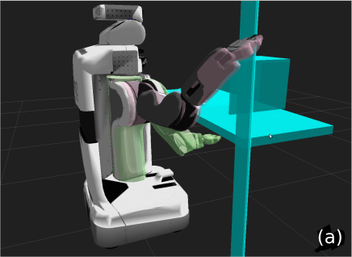
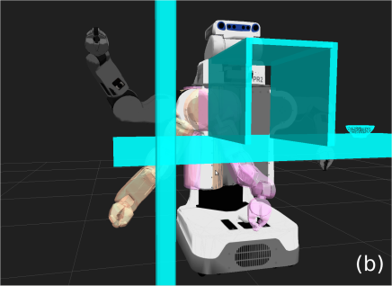
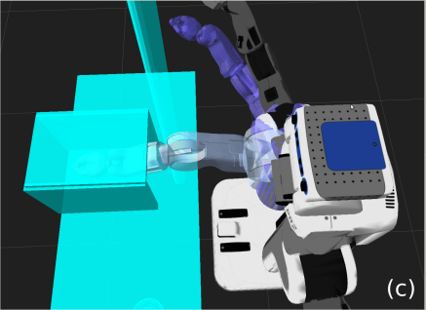
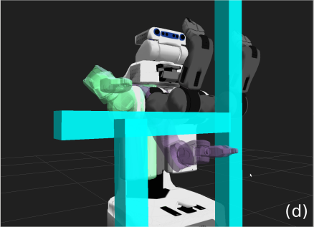
Results
Integrating into OMPL as a new collision call
Integrated with PRM, RRT, lazyPRM, and RRT* planners
No changes to the sampling or planning strategy
About 100% improvement in performance (till now)

Slide 9
Learning Curve
Performance increases with increased number of queries
should avoid adding items to database in well learned (sampled) region
learning improves performance

Slide 10
Conclusions
A probabilistic collision query based on prior collision queries and k-NN queries
General scheme to accelerate all sample-based planners
Theoretical guarantees on probabilistic completeness of the new planners
Easy to integrate with the planners

Slide 11
Future Work
Avoid updating database in well learned region
Handle dynamic environments
Hash table is extremely cheap to remove and update expired data
Cloud computing
Locality sensitive hashing fits well to map-reduce and can handle very large database of historical collision queries

Slide 12
Acknowledgements
NSF
Willow Garage

